Slide 1
ALGEBRA
BASICS 3
COORDINATE SYSTEMS

Slide 2
COORDINATE SYSTEMS
ORDERED PAIRS
RELATIONS

Slide 3
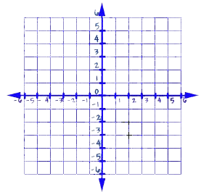
COORDINATE PLANE
A coordinate plane is
formed by two
intersecting number lines.

Slide 4
AXIS
y
The Horizontal line is called the x-axis.
The Vertical line is called the y-axis.
The two-axis system is called the coordinate system.
x
x
y

Slide 5
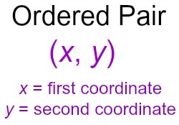
COORDINATE POINTS
The coordinates of a point are
represented by the ordered pair
(x, y)
Remember: x comes before y in the alphabet.

Slide 6

POINT
A point is a location.
It does not have shape or size.
It is always named by a capital letter.
Point A

Slide 7
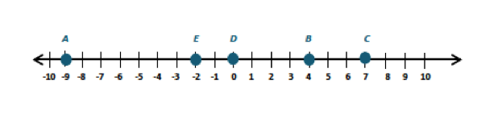
LINE
A line is made up of points and
has no thickness and no width.
There is exactly one line through any two points.

Slide 8
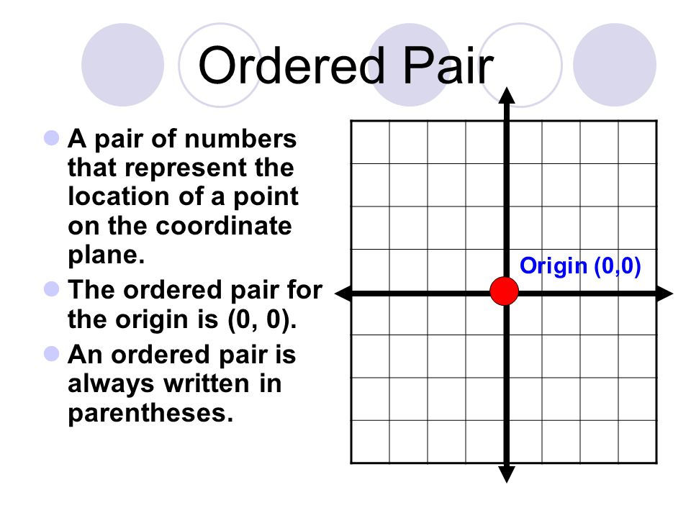
DISTANCE from POINT of ORIGIN
The ordered pair (x,y)
shows the distance from
the point of origin (0,0)

Slide 9
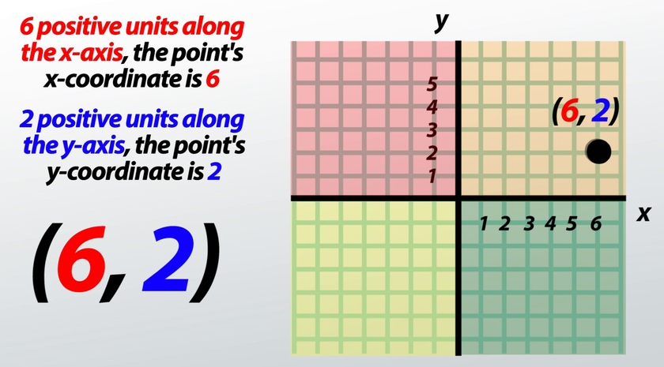

Slide 10
DOMAIN
All of the x coordinates are in the DOMAIN
In the list of ordered pairs: (2,5) (6,-2) (4,3)
2, 4, 6, are in the x domain.

Slide 11
RANGE
All of the y coordinates are in the RANGE
In the list of ordered pairs: (2,5) (6,-2) (4,3)
-2, 3, 5, are in the y range.

Slide 12
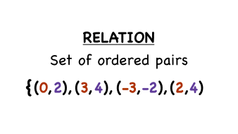
RELATION
The set of ordered pairs is called a relation.

Slide 13
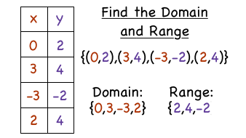
Use the Function Chart

Slide 14
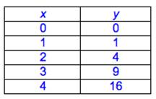
Find the domain and range.
What is the relation?
Domain: ____________
Range: _____________
Relation: ____________

Slide 15
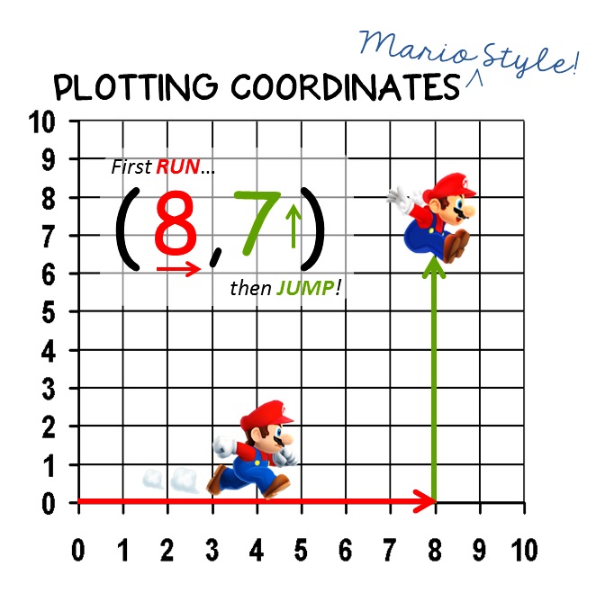

Slide 16
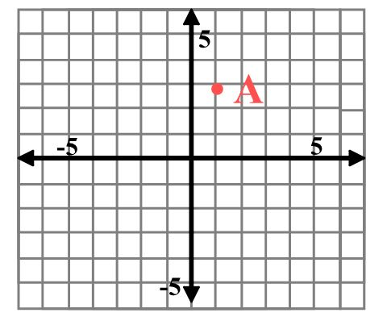
ORDERED PAIR
Write the ordered pair
for point A.
A = ( , )
x y

Slide 17
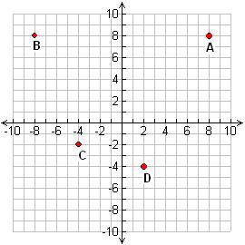
ORDERED PAIRS
Write the ordered pairs
for points
A = ( , )
B = ( , )
C = ( , )
D = ( , )

Slide 18
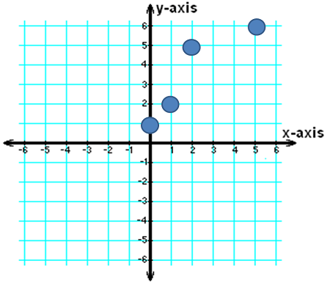
ORDERED PAIRS
Write the ordered pairs
for points
A = ( , )
B = ( , )
C = ( , )
D = ( , )
B
A
D
C

Slide 19
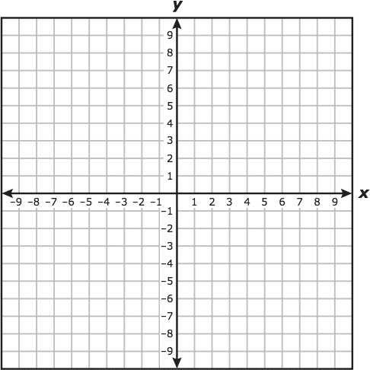
ORDERED PAIRS
Place points on the
coordinate grid.
Identify each point with
the corresponding capital letter.
A (2,3) B (-3,3) C (-5,-3) D (5,-3)

Slide 20
ORDERED PAIRS
Place points on the
coordinate grid.
Identify each point with
the corresponding capital letter.
Q (0, 6) R (0 ,-4) S (0,-6) T (4, 0)

Slide 21
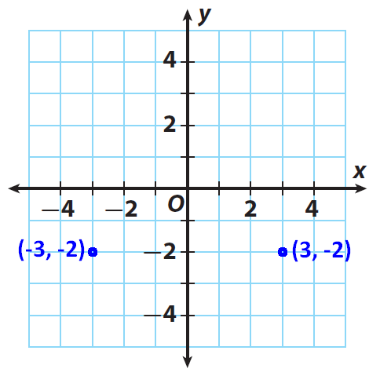
REFLECTIONS
When two ordered pairs are different only because of the sign - + the locations of the points is
said to be related by
REFLECTIONS across the axes.
(If you fold the paper in half on the
y axis the points are exactly the same)

Slide 22
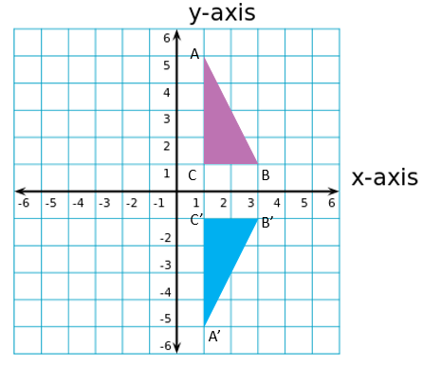
REFLECTIONS
Look at the right triangles.
They are reflections of each
other.
Write the ordered pairs for
A ( , ) B ( , ) C ( , )
A’ ( , ) B’ ( , ) C’ ( , )

Slide 23
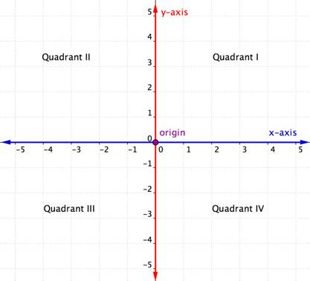
QUADRANTS
The intersecting x- and
y-axes divide the coordinate
plane into four sections.
These four sections are
called quadrants.

Slide 24
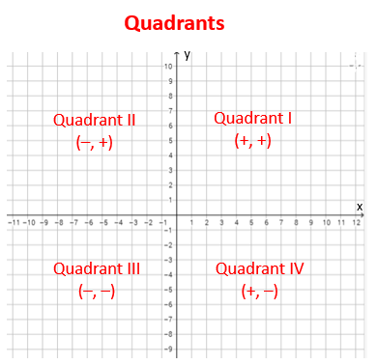
QUADRANTS
Quadrants are named using
the Roman numerals
I, II, III, and IV beginning with
the top right quadrant and
moving counter clockwise.

Slide 25
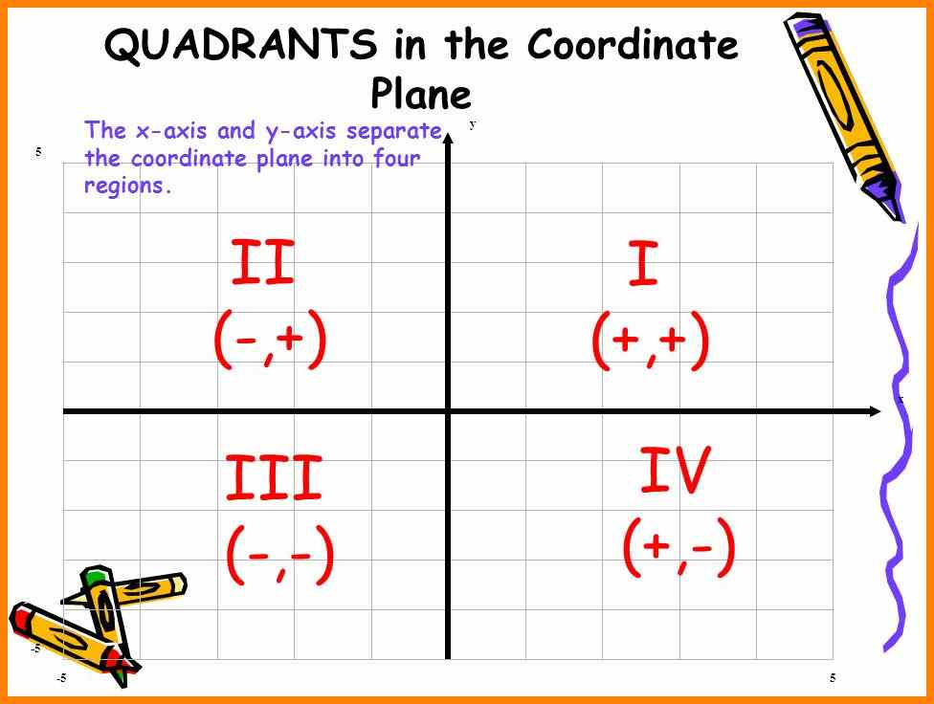

Slide 26
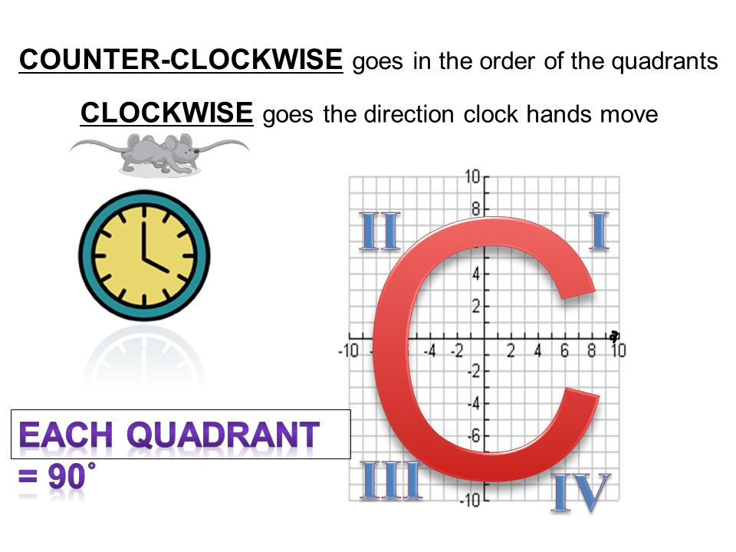
COUNTER-CLOCKWISE

Slide 27
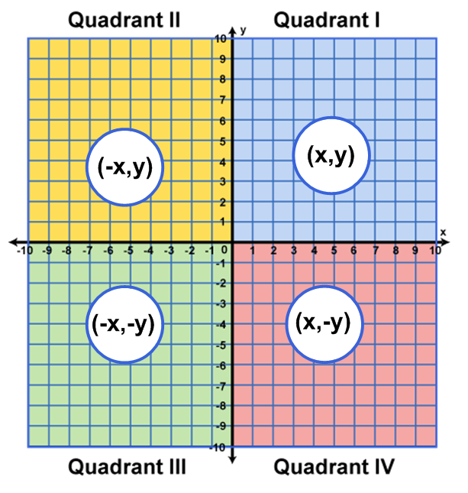

Slide 28
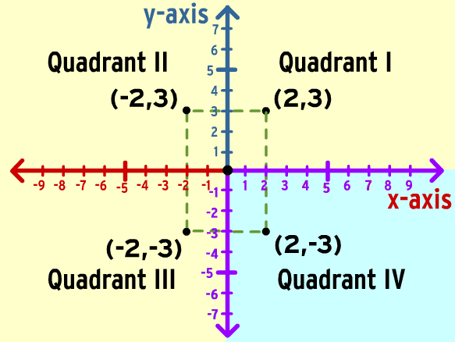

Slide 29
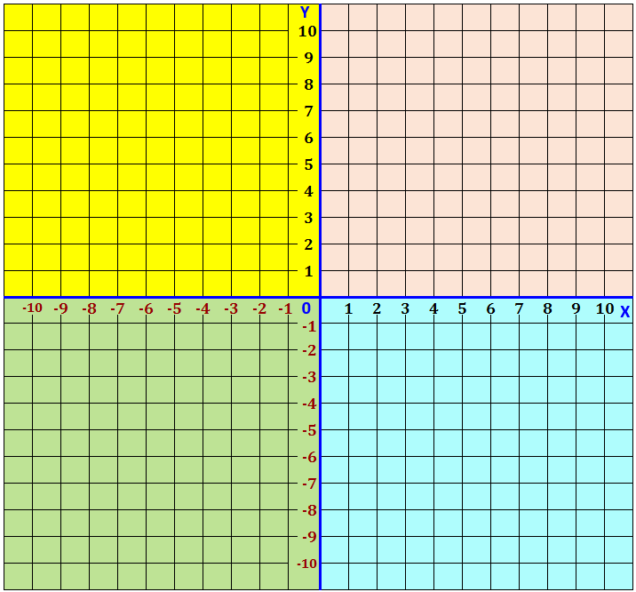
Label the Quadrants. I, II, III, IV

Slide 30
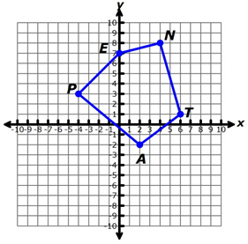
What are the coordinate points on this coordinate plane?
A ( , )
T ( , )
N ( , )
E ( , )
P ( , )
Remember: (x, y) x comes before y in the alphabet

Slide 31
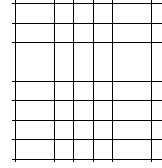
GRAPH DATA
You can graph data using ordered pairs.
Thomas has a summer job mowing lawns. He is paid $5 per hour. The amount he can earn in 4 hours is shown in the function table. Show hours worked on the x-axis, and dollars earned on the y-axis.
Graph the data.
Draw a line through
your data points.
y
30
25
20
15
10
5
Hours x | Dollars y
1 | 5
2 | 10
3 | 15
4 | 20
x
0 1 2 3 4 5 6

Slide 32
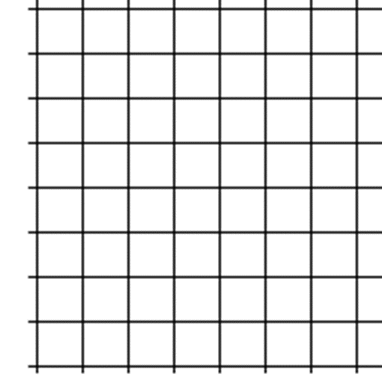
Graph the Data
Mr. Voss’ class is selling pizzas. They earn $2 from each pizza they sell. Make a table and then graph to show how much profit they will earn if they sell 10, 20, and 30 pizzas. Label the x axis and the y axis on your graph.
Profit x | Pizzas y

Slide 33
Graph the Data
Elizabeth makes $4 on every necklace she sells. Create a chart and then graph the data to show how much she will make if she sells 4, 6, 8, 10 and 12 necklaces. Make sure to label the x and y axes.
x | y

Slide 34
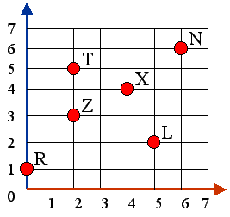
Check Point
Write the ordered pair for each coordinate point.
L ( , )
N ( , )
R ( , )
T ( , )
X ( , )
Z ( , )

